Slide 1

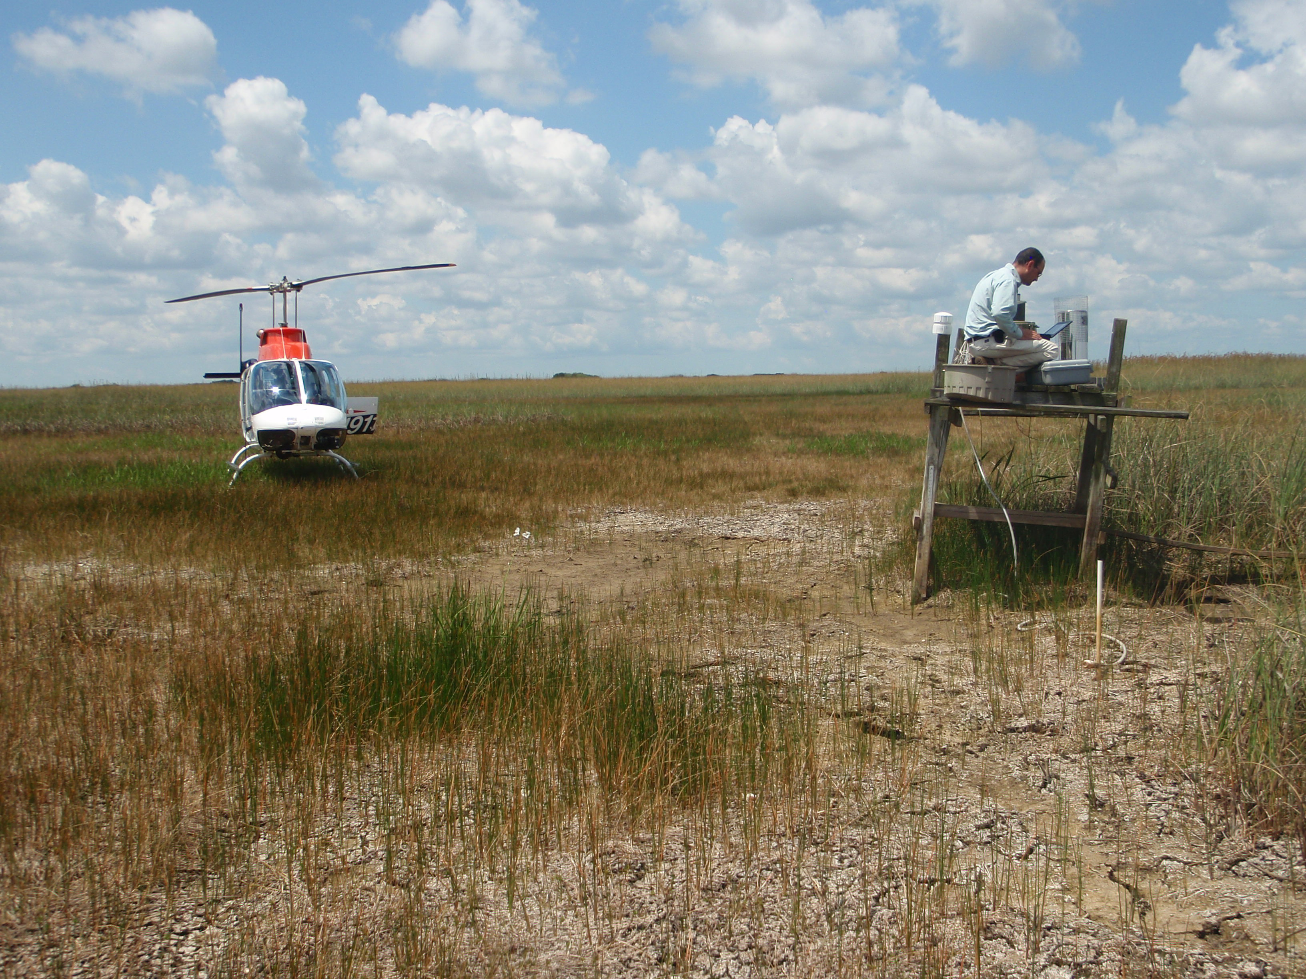
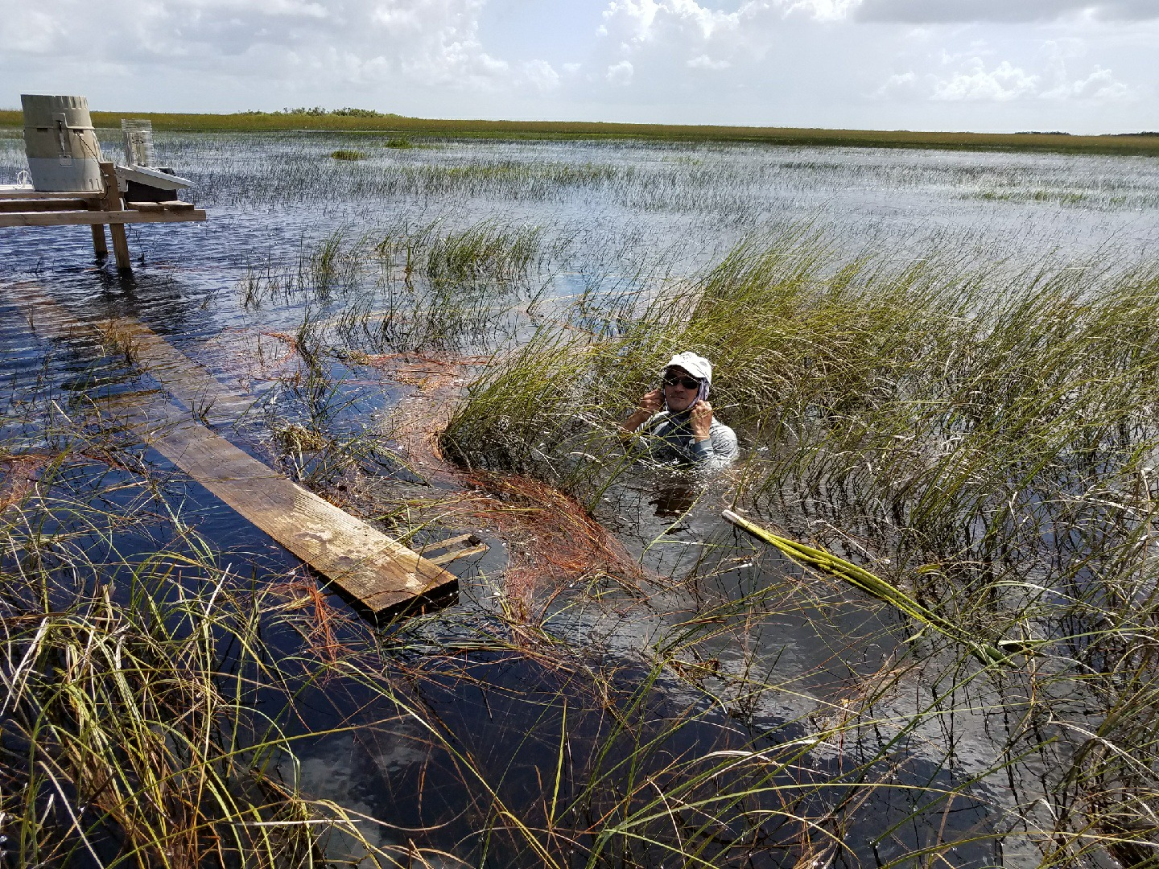
Question 4
Abiotic Resources & Stressors
Working Group Leaders: Evelyn Gaiser with Paul Julian, Rafael Travieso
and Edward Castañeda, Randy Chambers, Steve Davis, Jim Fourqurean, John Kominoski, and Tiffany Troxler
Very dry dry season
Very wet wet season
Site-based Research
March 2, 2022

Slide 2
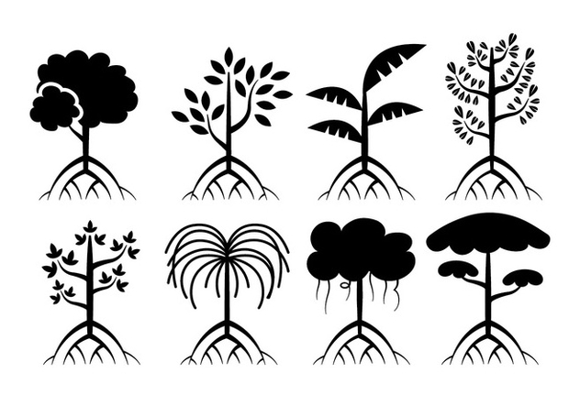



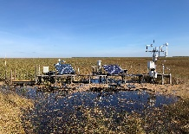
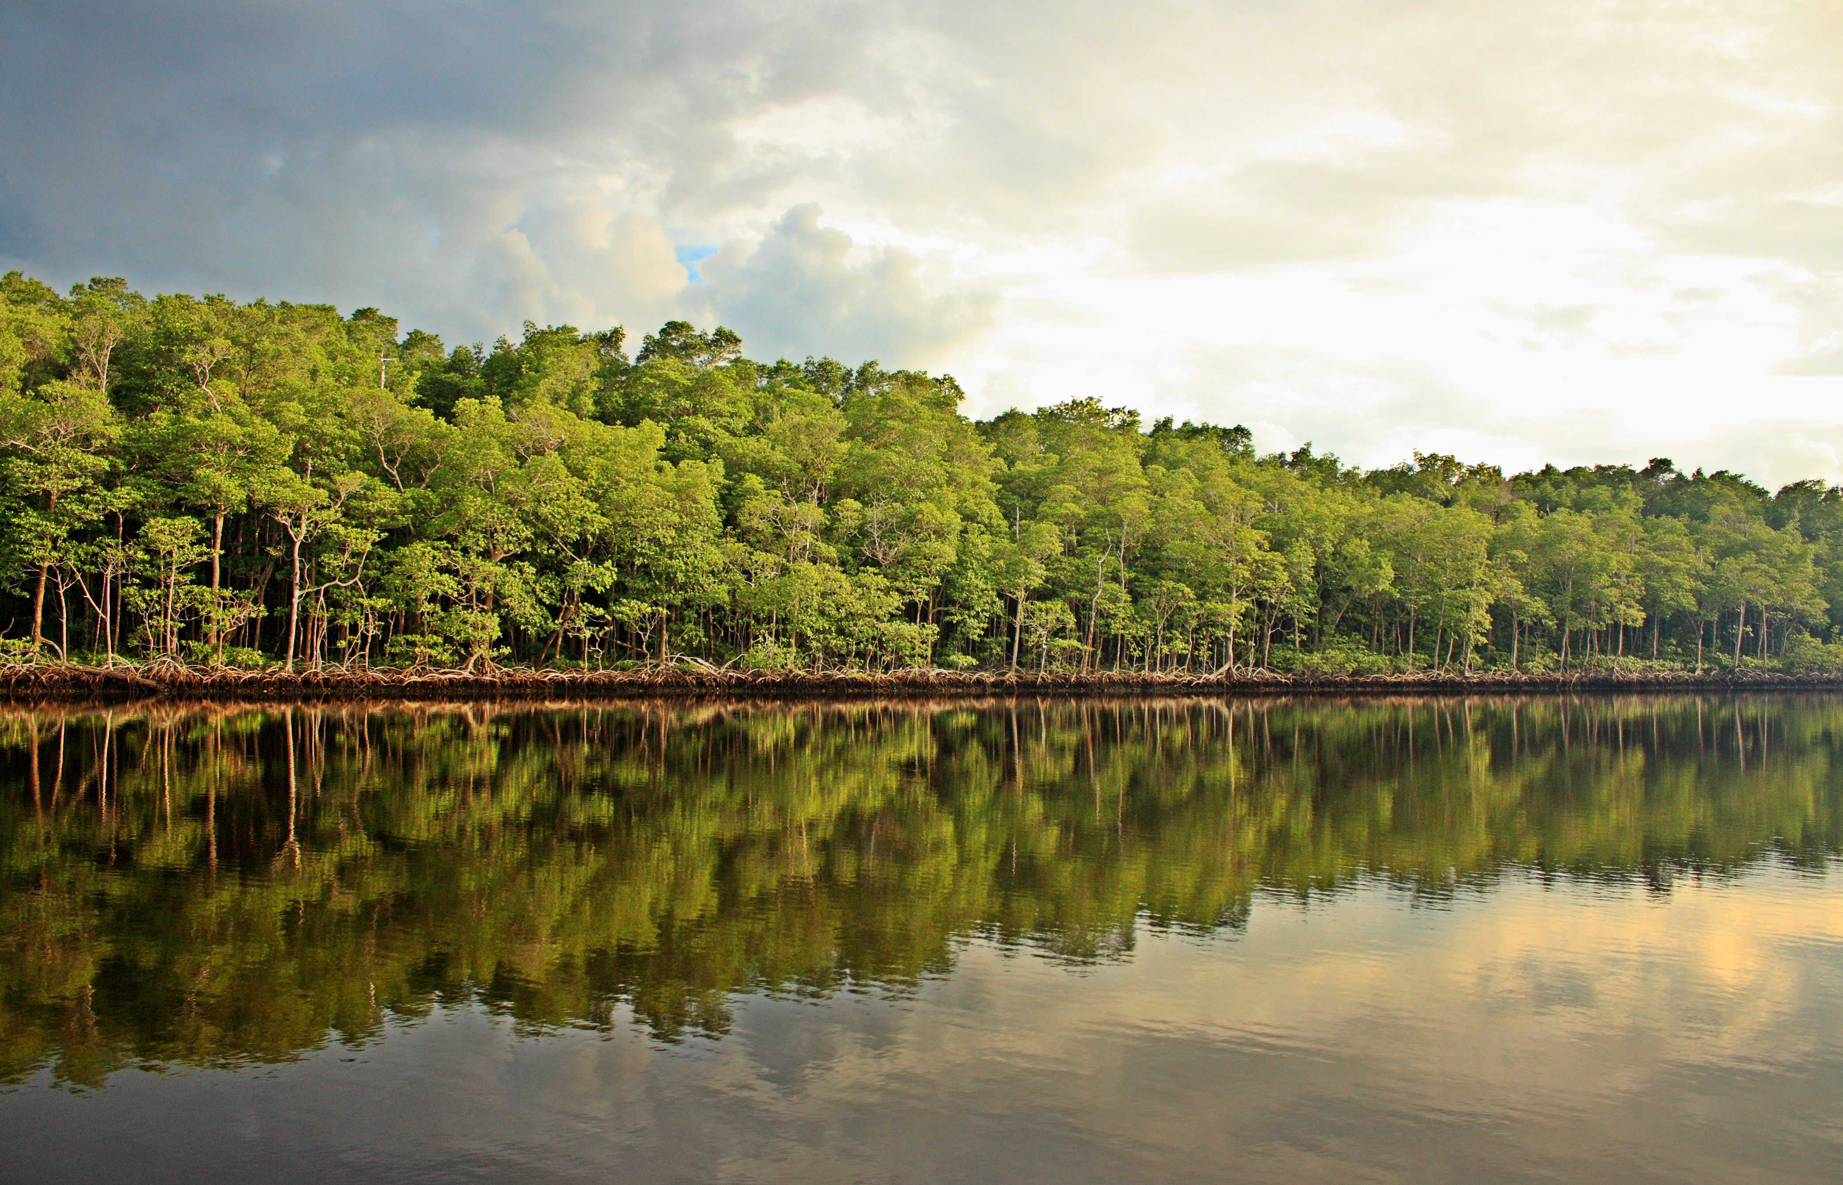
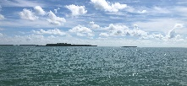
Question 4
Abiotic Resources & Stressors
QUESTION 4: How will increased pulses of fresh and marine water and their associated resources change ecosystem structure and functions that control ecosystem development trajectories in coastal ecosystems facing the press of accelerating sea-level rise?
Hierarchical Social-Ecological Drivers of Coastal Ecosystem Development
Exogenous Drivers of Hydrologic Presses & Pulses
Climate Variability & Change (sea-level rise, storms, rainfall, temperature)
Endogenous Filters & Responses
Freshwater Governance
Cultural & Economic Values
Social
Ecological Landscape
Evapotranspiration Feedback
Landscape
Freshwater press & pulses
Hydrologic Connectivity & Consumer-Mediated Nutrient Transport
Marine press & pulses
Freshwater Marsh
Mangrove
Seagrass/Marine
Water Level
Water Level
Time
Time
Vegetation & Geomorphic Gradients
Elevation Feedbacks
Ecosystem Structure & Functions
=⨏{
Consumers
}
Carbon Stocks
Vegetation
Carbon Fluxes
Detritus & Microbes
Time
Ecosystem Trajectories
Abiotic Resources & Stressors
(water level, phosphorus, sediment, salinity)
Ecosystem Service Feedbacks
Site-based Research
March 2, 2022

Slide 3
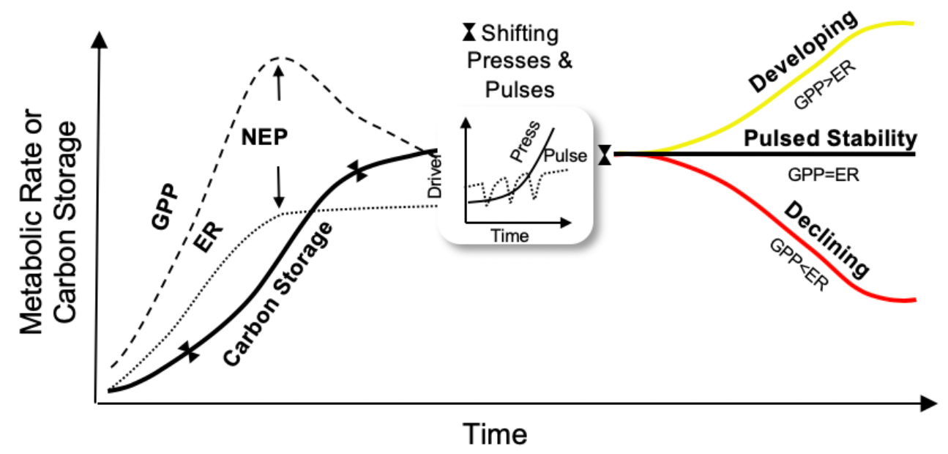
Question 4
Abiotic Resources & Stressors
Hypotheses
A biophysical data platform supporting all hypotheses for comparing responses to changing freshwater and marine pulses between two drainages of contrasting hydrologic connectivity
Kominoski, Gaiser, & Baer (2018) BioScience
Site-based Research
March 2, 2022

Slide 4
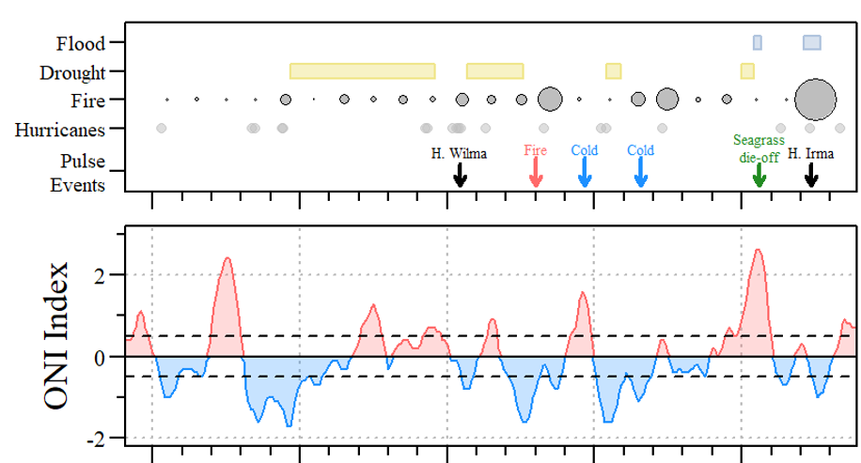
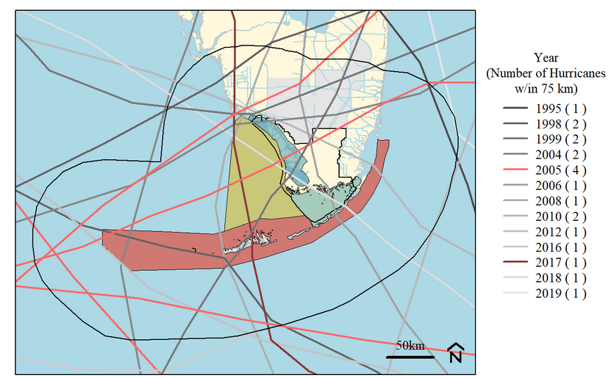
Question 4
Abiotic Resources & Stressors
Disturbance drivers of FCE pulses
FCE Hurricanes 1995-2020
Site-based Research
March 2, 2022

Slide 5
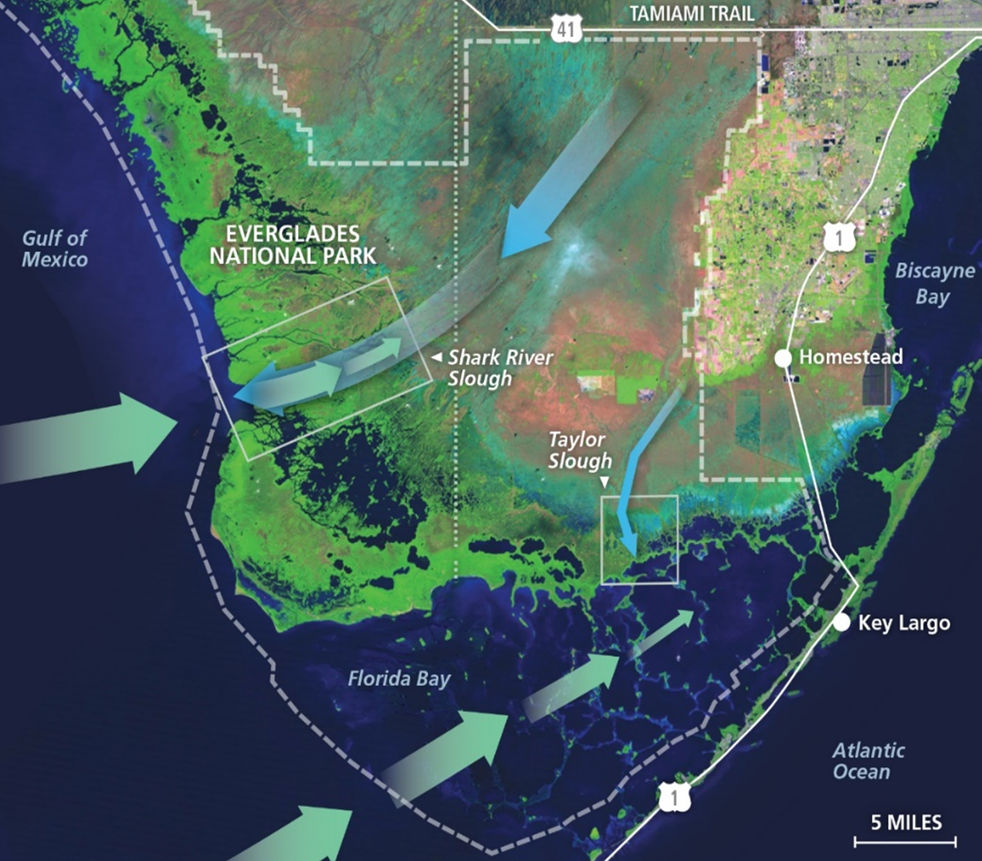
Question 4
Abiotic Resources & Stressors
Goals
Determine the amplitude and duration of water column salinity, sediment, and P pulses in relation to daily, seasonal, and event-driven variability in water levels, seasonal freshwater inflows, storm surge pulses, and tides
Measurements: Surface water salinity & dissolved nutrients (monthly), total organic carbon and nutrients (3-5 day), porewater salinity & continuous temperature (new)
1
Freshwater
2
3
4
1
6
5
2
3
6
Marine
7
9
10
10
11
11
Site-based Research
March 2, 2022

Slide 6
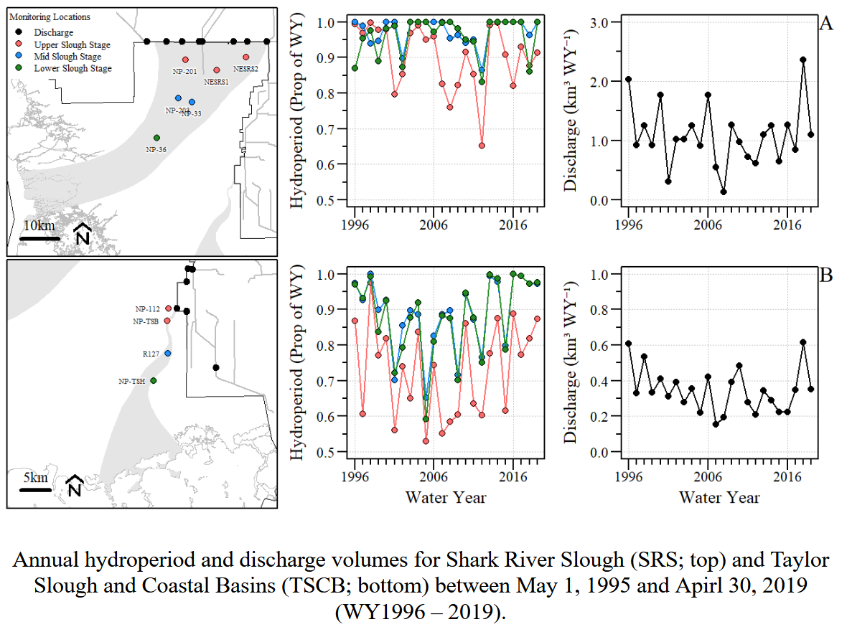
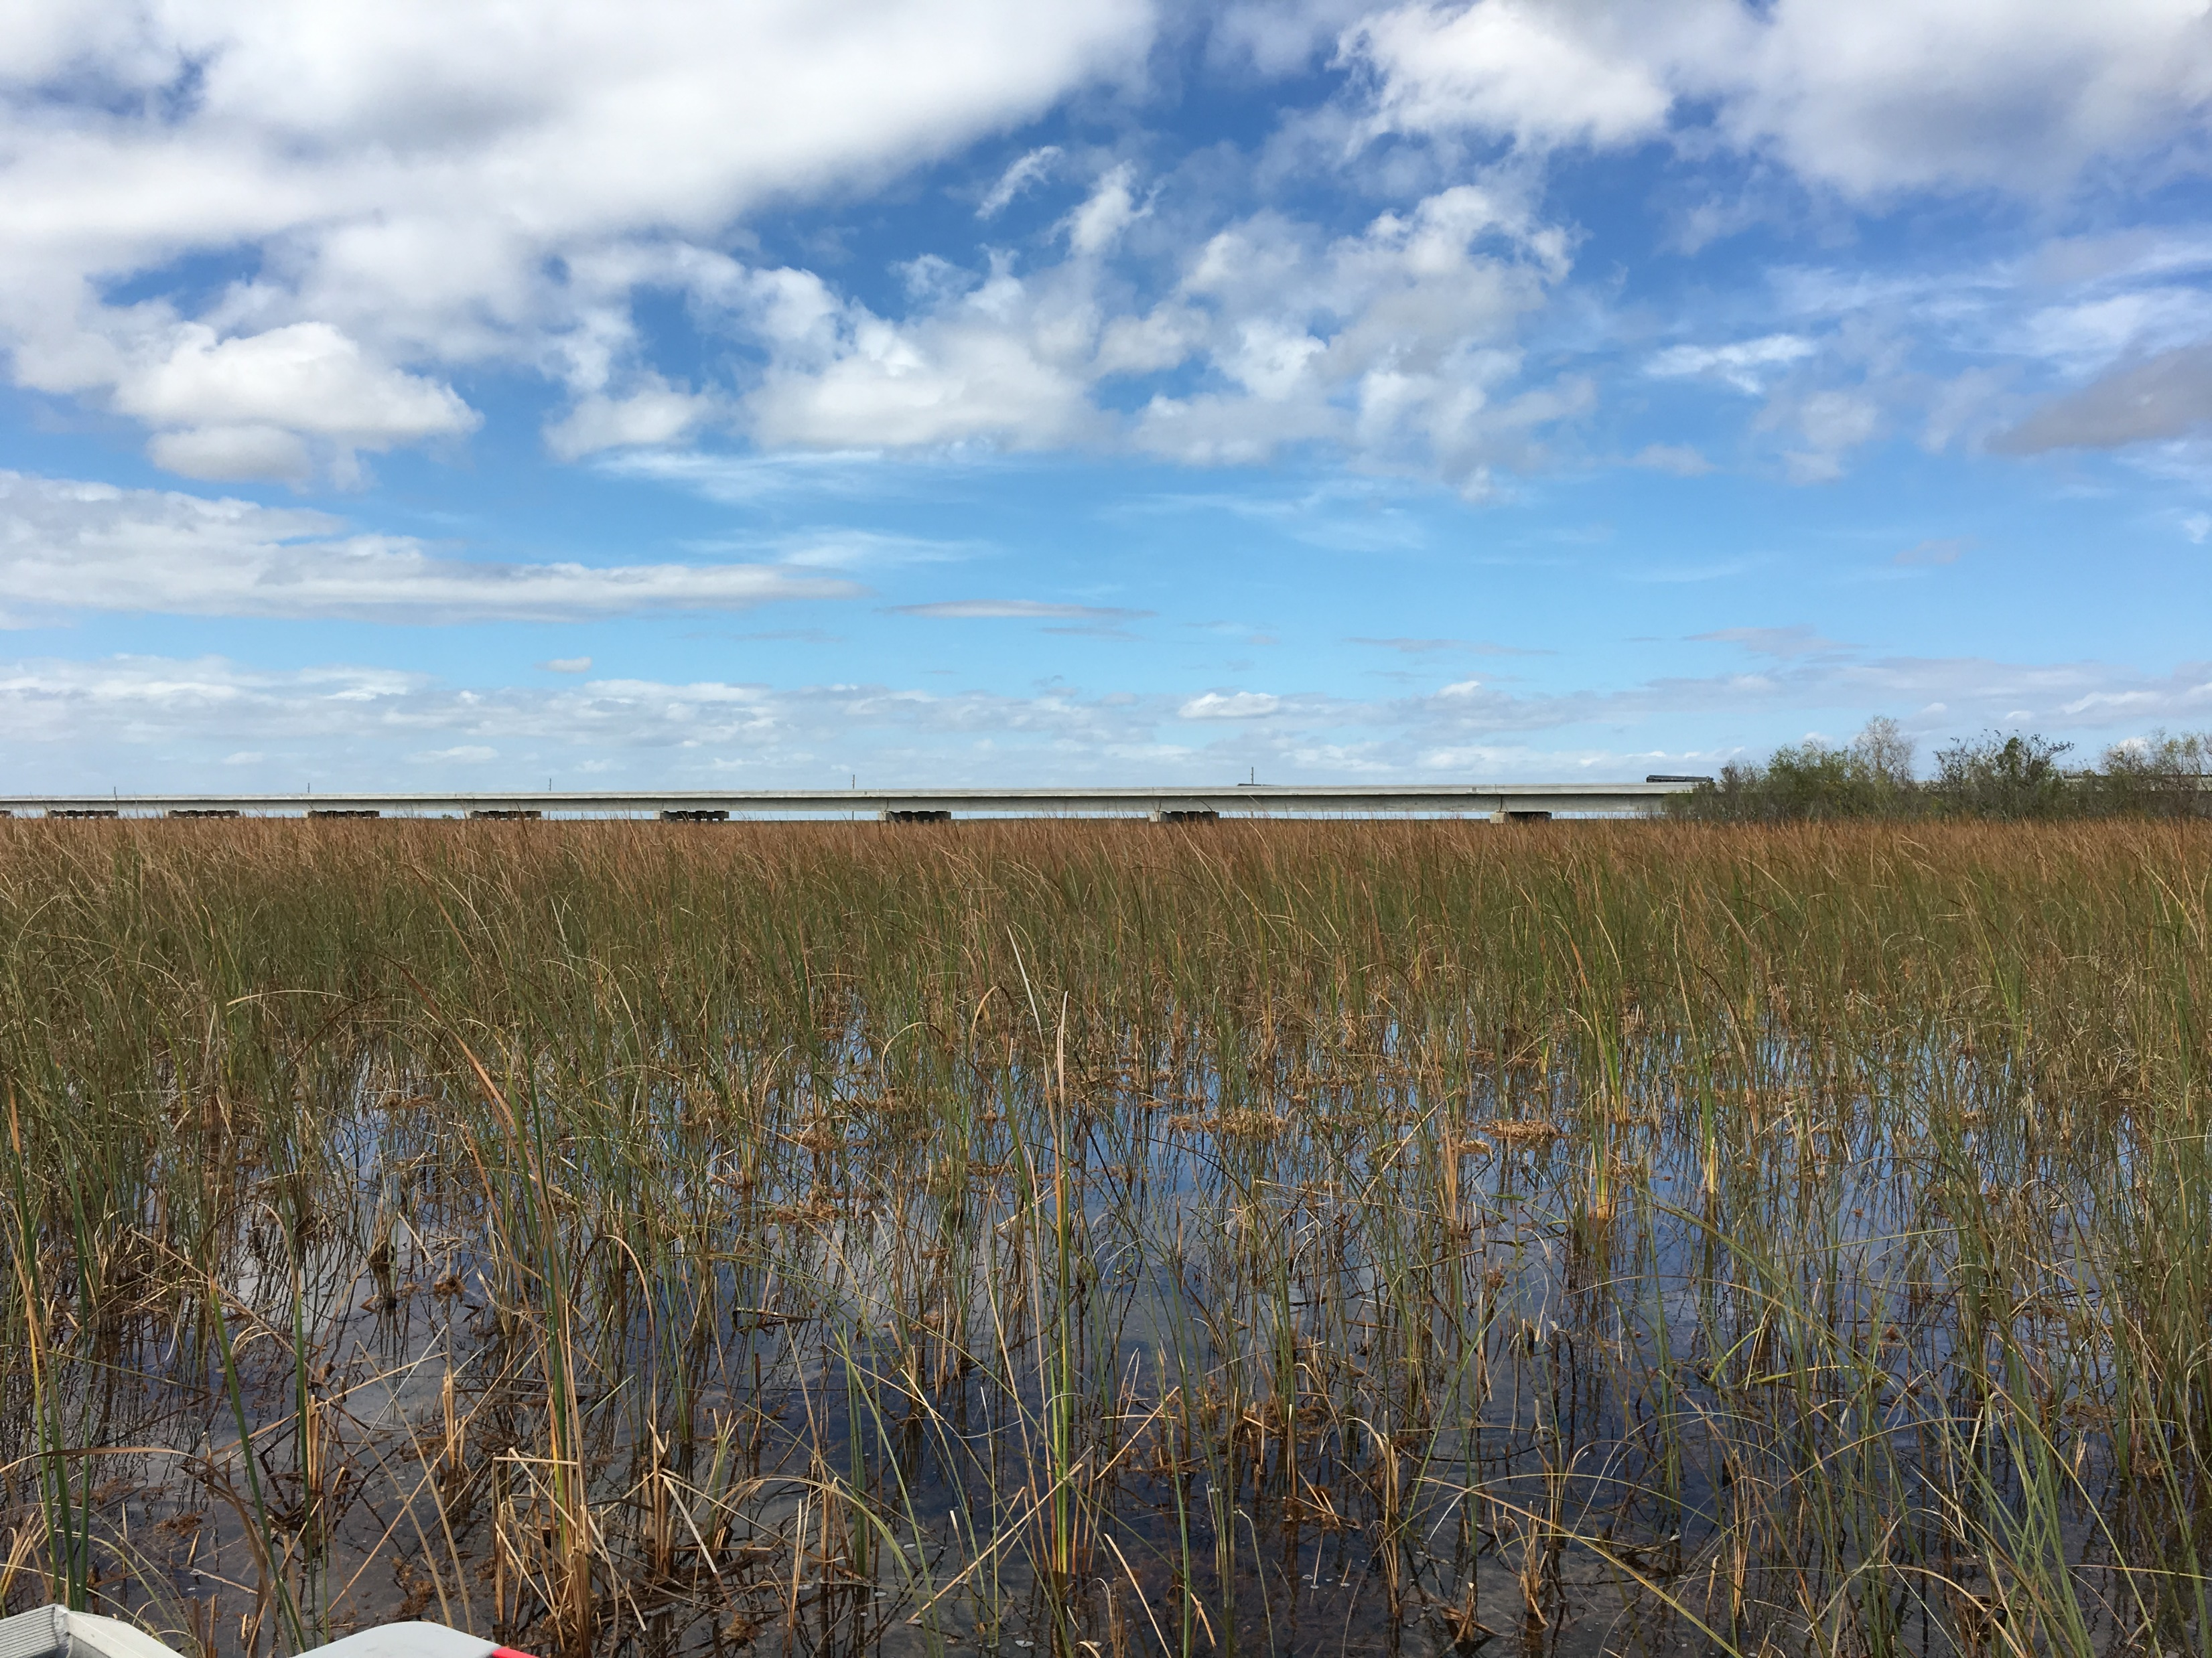
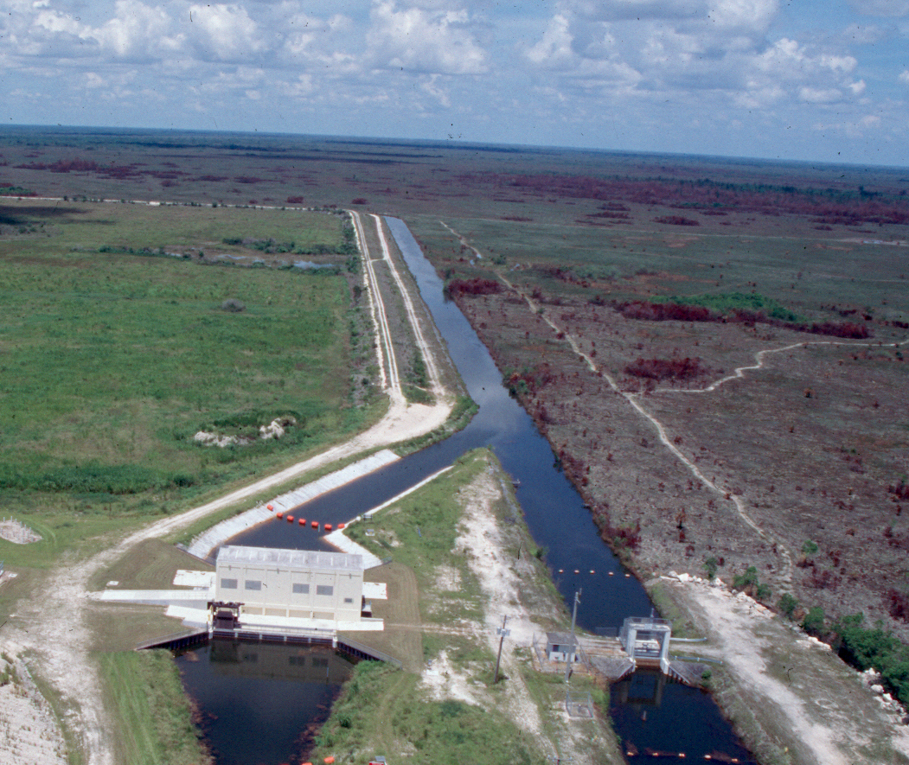
Question 4
Abiotic Resources & Stressors
Freshwater Presses & Pulses
Bridges
Drought
Drought
Drought
IOP-ERTP Operations
Site-based Research
March 2, 2022

Slide 7
Question 4
Abiotic Resources & Stressors
Freshwater Presses & Pulses
1985-1999
Canals divert water away
2000-2011
Water retention projects
2012-2020
Restoration projects
Site-based Research
March 2, 2022

Slide 8
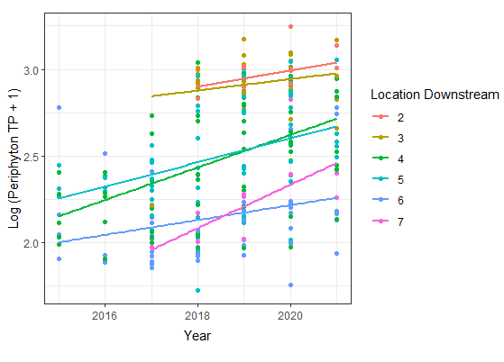
Question 4
Abiotic Resources & Stressors
Freshwater pulses drive legacy P movement
Legacy P
Increasing distance from L-29 canal
Legacy P
10
10
Periphyton TP and eutrophic diatoms increasing where increased flow pulses mobilize legacy P
Sarker et al. (2020, Restoration Ecology)
11
11
Site-based Research
March 2, 2022

Slide 9
Question 4
Abiotic Resources & Stressors
Freshwater pulses drive legacy P movement
Legacy P
Increasing distance from L-29 canal
Legacy P
Marine
10
10
Periphyton TP and eutrophic diatoms increasing where increased flow pulses mobilize legacy P
Sarker et al. (2020, Restoration Ecology)
11
11
Site-based Research
March 2, 2022

Slide 10
Question 4
Abiotic Resources & Stressors
Freshwater Phosphorus Presses & Pulses
Restoration→
Pulse duration increasing in SRS marshes
Pulse amplitude and duration increasing in TS/Ph marshes
Pulse legacies driving long-term press
H. Wilma
Drought
Drought
H. Irma
Fire
FCE Region | TP Press Trend | TP Pulse Duration | TP Pulse Amplitude
SRS Marsh | + | +
TS/Ph Marsh | + | + | +
See Onwuka et al. (2021, Water) for detailed pulse analysis
Site-based Research
March 2, 2022

Slide 11
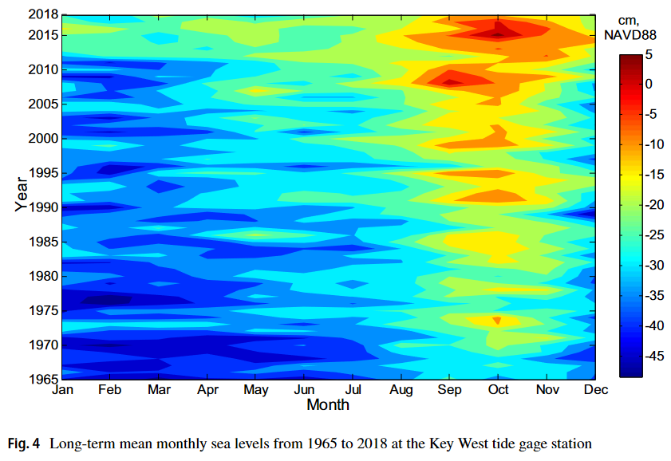
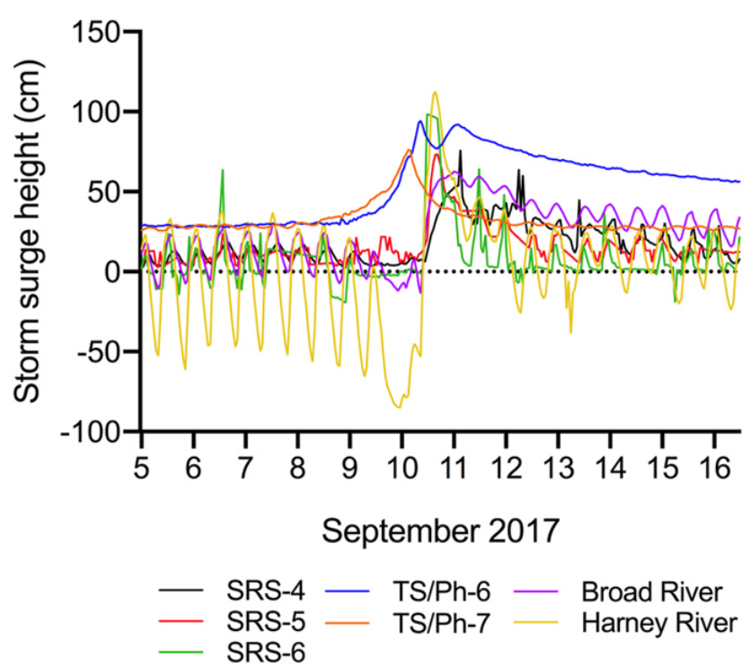
Question 4
Abiotic Resources & Stressors
Marine Presses & Pulses
Sea level rise increasing wet season water levels
Dessu et al. (2021, Climatic Change)
Hurricane Irma storm surge
Castañeda-Moya et al. (2020, PNAS)
Site-based Research
March 2, 2022

Slide 12
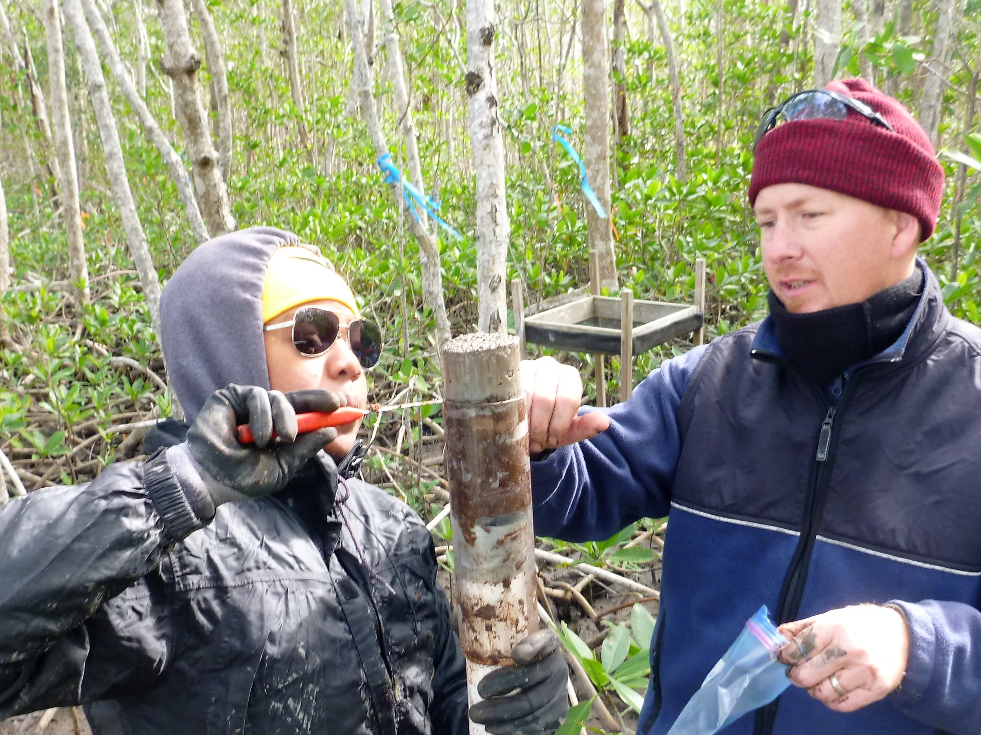
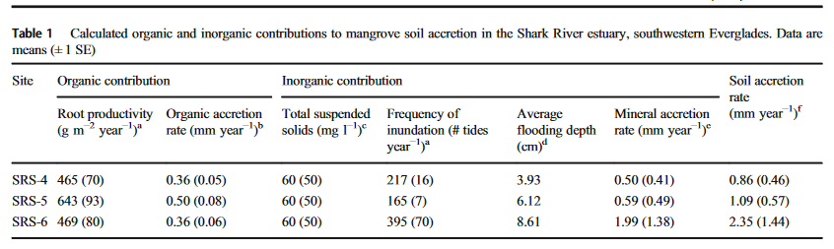
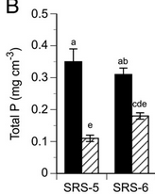
Question 4
Abiotic Resources & Stressors
Marine pulse legacies
Increasing mineral accretion with increasing inundation
Chambers et al. (2021, Estuaries & Coasts)
Photo Credit: Donny Smoak
Storm-deposit P in soils is highly mobile and moves upstream
Castañeda-Moya et al. (2020, PNAS)
Nia Hurst and Joshua Breithaupt with a sediment core showing ~ 4 cm storm surge deposit
Mineral Deposit
Peat
Site-based Research
March 2, 2022

Slide 13
Question 4
Abiotic Resources & Stressors
Marine Phosphorus Presses & Pulses
Long-term pulse increase not detected but hurricanes and droughts have left long legacies
H. Wilma
Drought
Drought
H. Irma
Fire
FCE Region | TP Press Trend | TP Pulse Duration | TP Pulse Amplitude
SRS Mangroves | +
TS/Ph Mangroves | +
TS/Ph Seagrass | +
Site-based Research
March 2, 2022

Slide 14
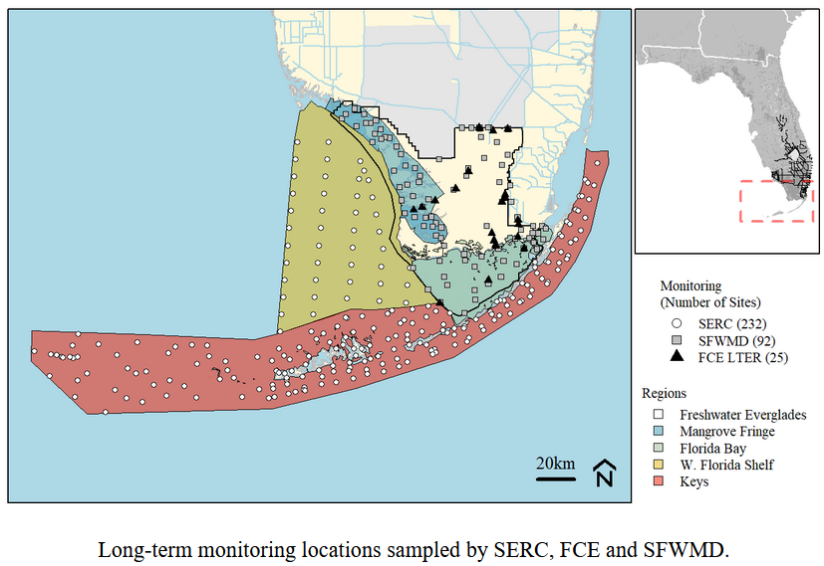
Question 4
Abiotic Resources & Stressors
Integration: System-wide water quality dynamics
Julian, Fourqurean, Davis, Surratt, Gaiser, & Kominoski (in prep.)
Site-based Research
March 2, 2022

Slide 15
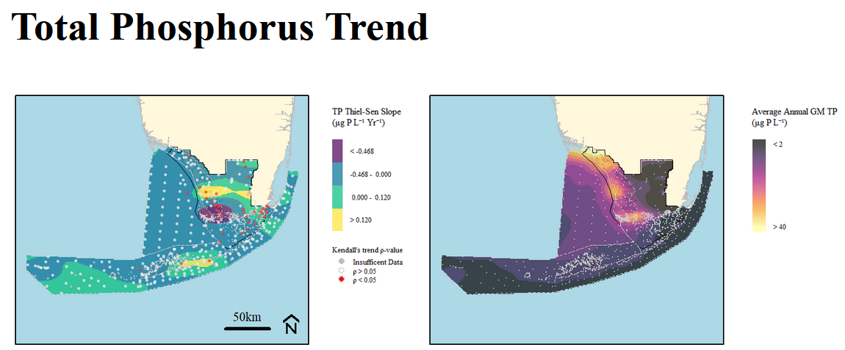
Question 4
Abiotic Resources & Stressors
Total Phosphorus Trends
Spatial Trends:
Hot spots in the fertile crescent (upside-down estuary)
Temporal Trends:
Increases in the ecotone
Site-based Research
March 2, 2022

Slide 16
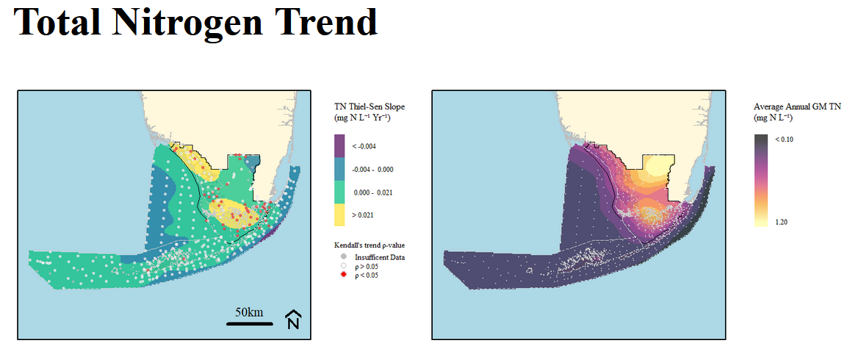
Question 4
Abiotic Resources & Stressors
Total Nitrogen Trends
Spatial Trends:
Hot spots in the freshwater marshes
Temporal Trends:
Increases in western Everglades and central Florida Bay
Site-based Research
March 2, 2022

Slide 17
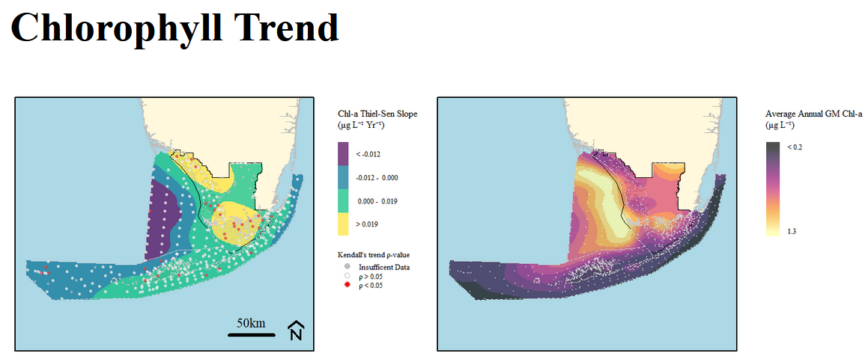
Question 4
Abiotic Resources & Stressors
Chlorophyll a Trends
Spatial Trends:
Hot spots in the fertile crescent (upside-down estuary)
Temporal Trends:
Increases in the western Everglades and central Florida Bay/fertile crescent
Site-based Research
March 2, 2022
Hot spots along the coastal margin, increases in western Everglades and central Florida Bay

Slide 18
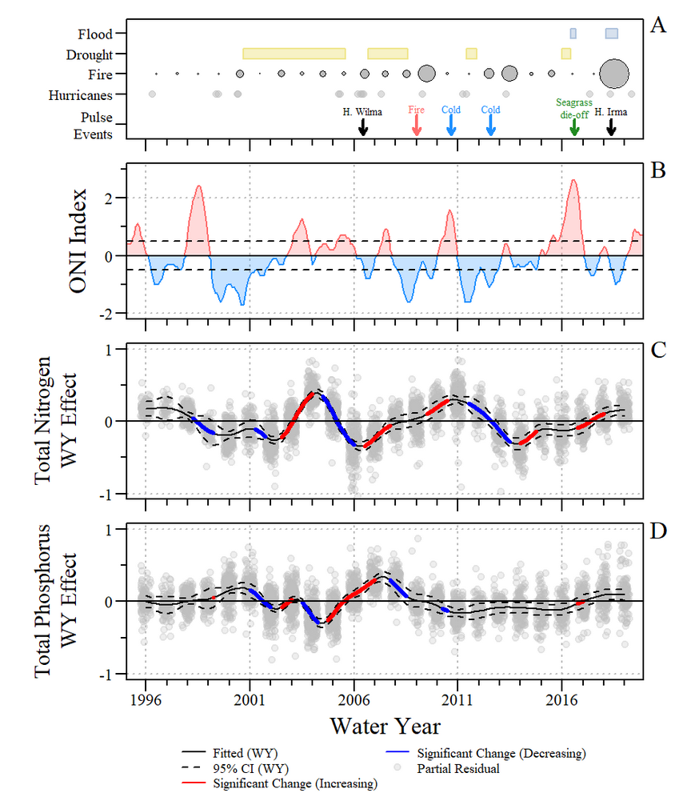
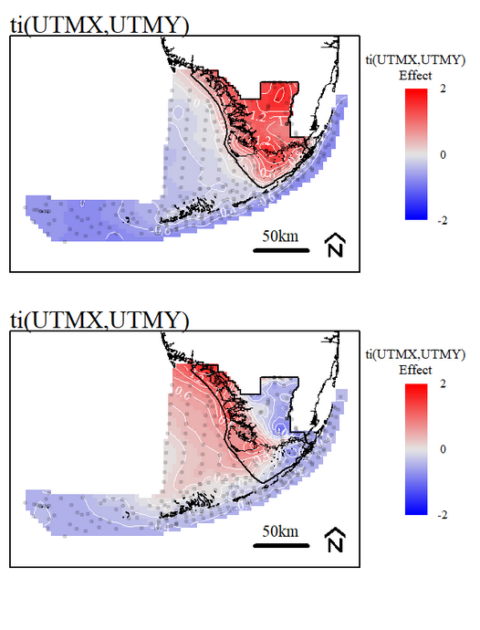
Question 4
Abiotic Resources & Stressors
Integration: System-wide water quality dynamics
Total nitrogen pulses coincide with droughts, cold snaps
Total phosphorus pulses coincide with hurricanes
Seagrass die-offs influence both, suggesting a biological feedback to water quality pulses
Site-based Research
March 2, 2022

Slide 19
Question 4
Abiotic Resources & Stressors
Summary
FCE Region | TP Press Trend | TP Pulse Duration | TP Pulse Amplitude
Whole System | + | + | +
Climate variability change and freshwater restoration are amplifying water pulses across the system that are increasing the amplitude and duration of TP pulses. Accumulating legacies are increasing P availability throughout the FCE.
Site-based Research
March 2, 2022

Slide 20
Question 4
Abiotic Resources & Stressors
Advancing Social-Ecological Research
Through their interactive effect on resource availability, fresh and marine water pulses will determine whether vegetated ecosystems continue to develop or decline to open water states in the presence of an increasing stressor.
Drought-induced seagrass die-off elicited a quasi-stable state transition to phytoplankton dominance via a resource pulse feedback that may be mediated by amplifying water pulses.
High
Vegetated
ecosystem
Either state
Pulses
(Fresh & Marine Water Pulses)
+↑
Feedbacks
-↓
Open water state
Low
Low
Press
(Saltwater Intrusion)
High
(after Ratajczak et al. 2018)
Site-based Research
March 2, 2022

Slide 21
Extra slides

Slide 22
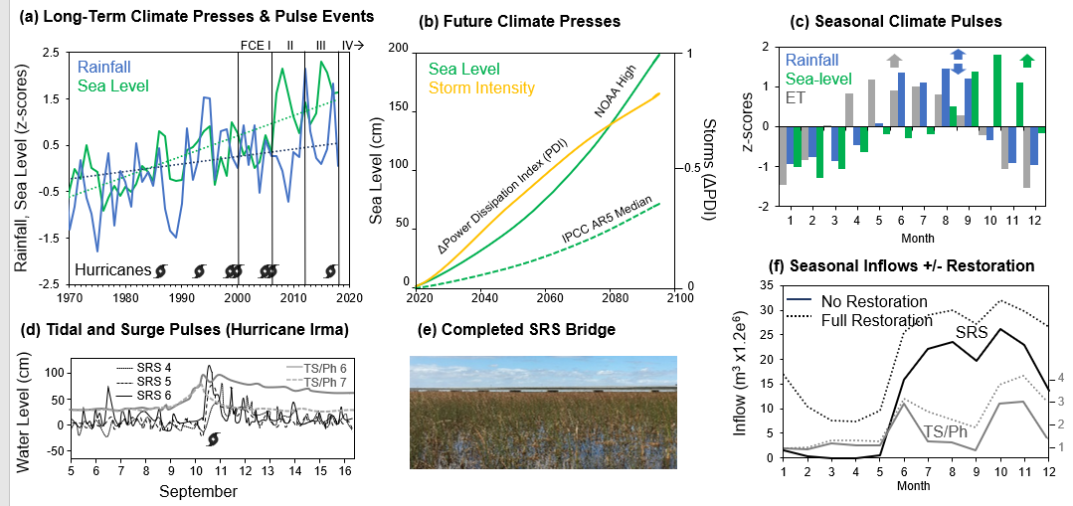
Question 4
Abiotic Resources & Stressors
FCE Hydrologic Presses & Pulses
10
11
Site-based Research
March 2, 2022

